Slide 1
Treating Security as a Data Discipline in Your Organisation
Redgate Summit, London

Slide 2



















“It's not a matter of if, but when…”

Slide 3





Danny de Haan
Abhi Jayanty
he/him
Solutions Engineer
Redgate Software
he/him
Data Engineer
Quorum
/in/dannydh/
ThatInfraDba@pm.me
www.thatinfradba.com
/in/abhinav-j/
abhi.jayanty@outlook.com

Slide 4
Session goals
01
02
03
04
Security, Compliance, Governance & Standards
Auditing the Data Platform
Analytics & Practical Examples
Keystones & Next Steps

Slide 5

Security is optional

Slide 6

Compliance != Security

Slide 7
Standards
NIST CSF
PCI-DSS
COBIT
ISO 27000 series
NIST 800 series
CIS v8
SOC 1/2/3
FTC Safeguards
CISA CPG
HIPAA/HITECH
CMMC
Common Criteria
FedRAMP
TRUSTe
CSA STAR
SOX
FINRA
NERC CIP
CAN/CIOSC 104:2021
UK Cyber Essentials Plus
GDPR
CPR
NORA
DORA(2)
And many, many more…

Slide 8

They can be grouped
The important part are the redlines
Identify, Protect, Detect, Respond, Recover

Slide 9
Compliance
Review a risk
Create policies to mitigate that risk
Create the controls
Document the steps and results
External reviews

Slide 10
Why is Compliance important?
It helps in litigation
It helps protect reputation
It helps to avoid further damage

Slide 11
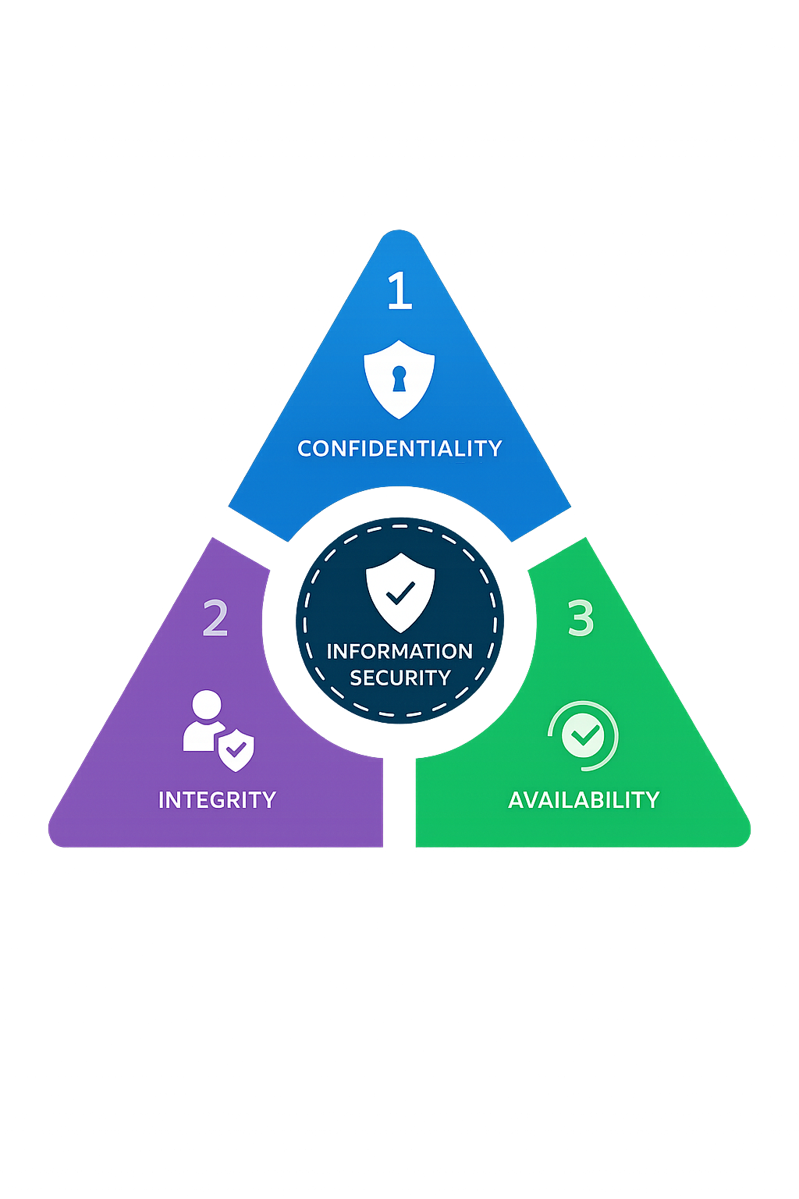
Business Risk Appetite
CIA triad
Confidentiality
Integrity
Availability
Risk Tolerance / Appetite

Slide 12
Strategy Framework
Identify
Assess
Respond

Slide 13
The Gap: Security Data Lacks Structure
✓ Business Data
✗ Security Data
Data Models
Defined schemas, documented relationships
Data Models
Ad-hoc log formats, vendor-specific, inconsistent
Retention
Clear policies, tiered storage, lifecycle management
Retention
Keep everything or delete arbitrarily
Why do we treat security telemetry differently from any other organisational data?
Governance
Ownership, access controls, quality checks
Governance
Assumed handled by the tool, rarely reviewed
Query Design
Optimised, indexed, tested for performance
Query Design
Broad searches, slow investigations, guesswork
Reporting
Dashboards, KPIs, trend analysis
Reporting
Manual, reactive, post-incident scramble

Slide 14
Data Platform Security
(SQL Server) Error Log
OS Metrics/logs
Logon/Logoff metrics
IAM logs
Encryption changes
Data Access entries
Set up changes
Back-up & Recovery logs
Etc. etc.

Slide 15
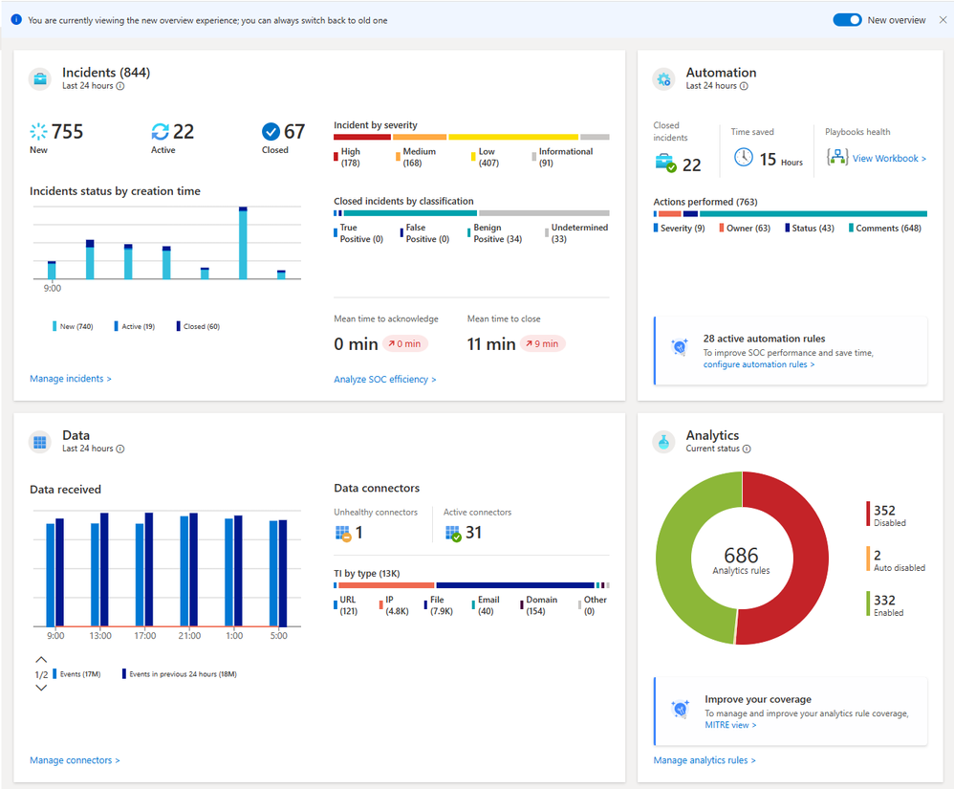
Security Observability

Slide 16
Security Observability - Incidents

Slide 17
Security Observability - Automation

Slide 18
Security Observability - Data

Slide 19
Security Observability - Analytics

Slide 20
Security Observability

Slide 21
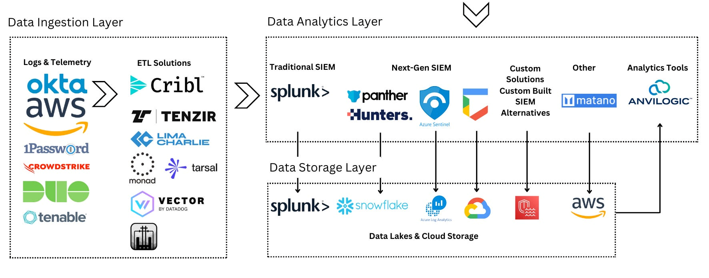
Data Engineering for Security

Slide 22
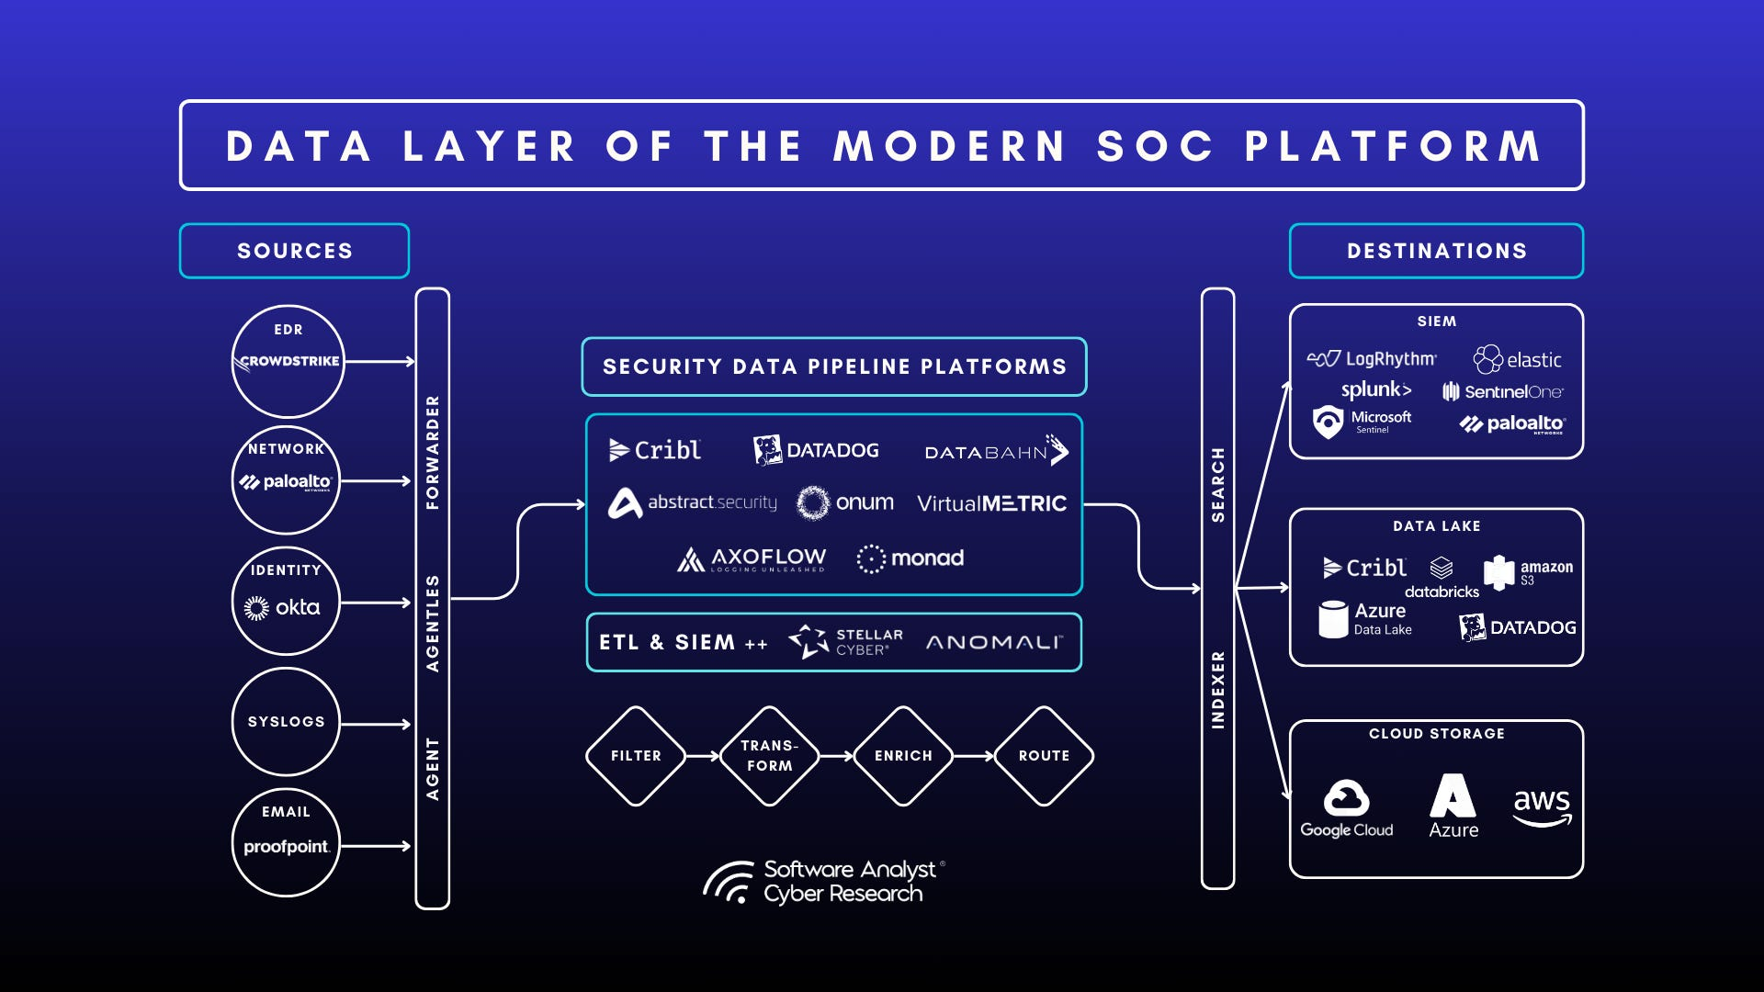

Slide 25
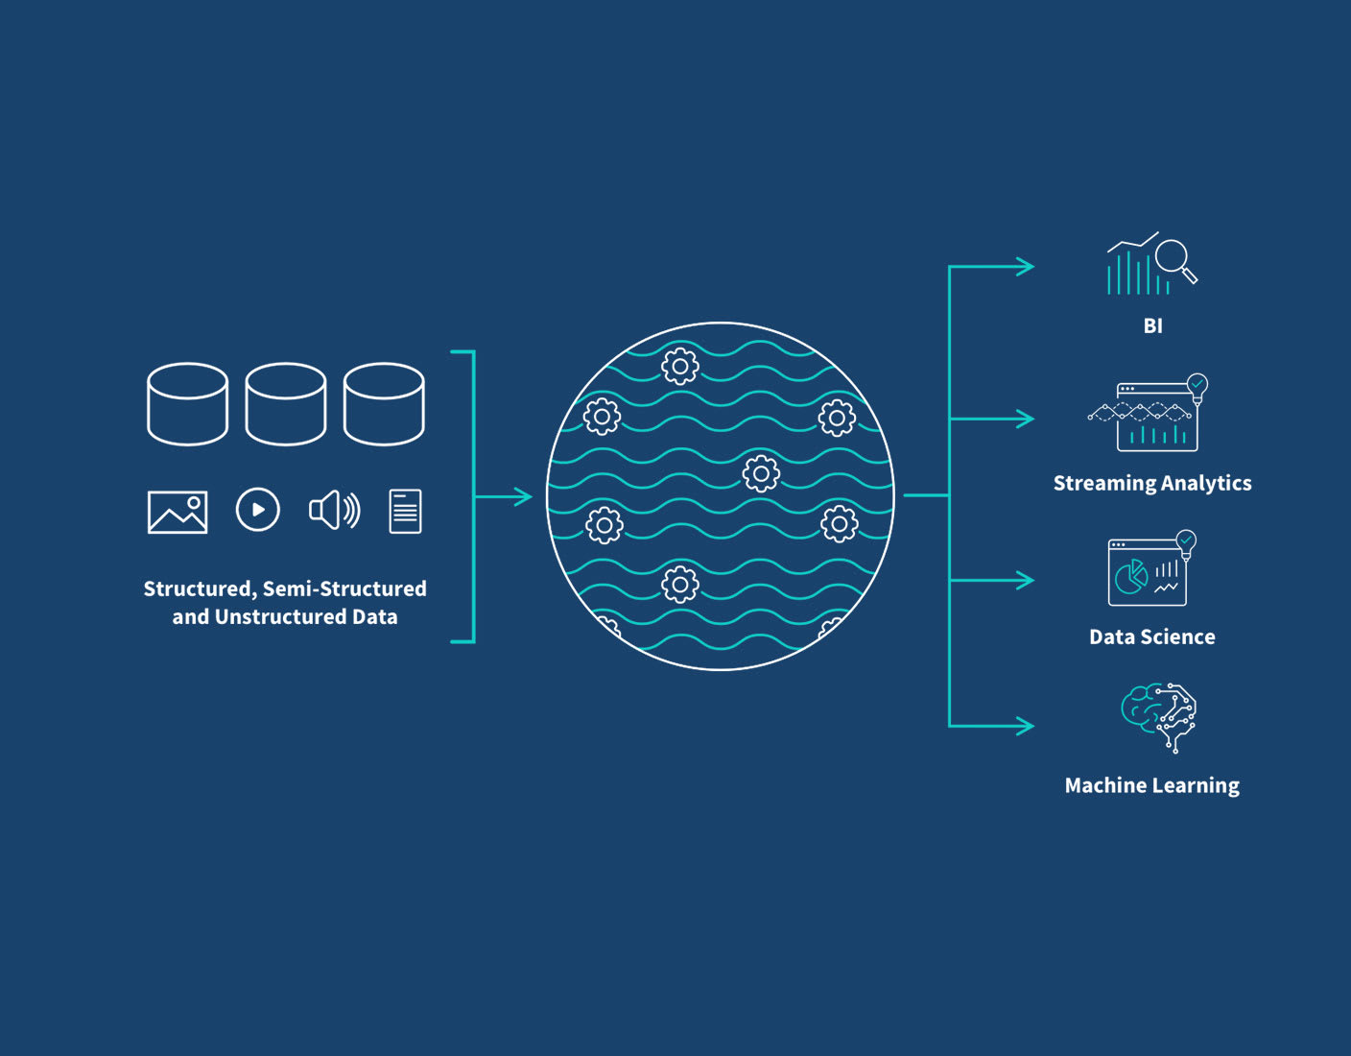
“Data Lakes”

Slide 26
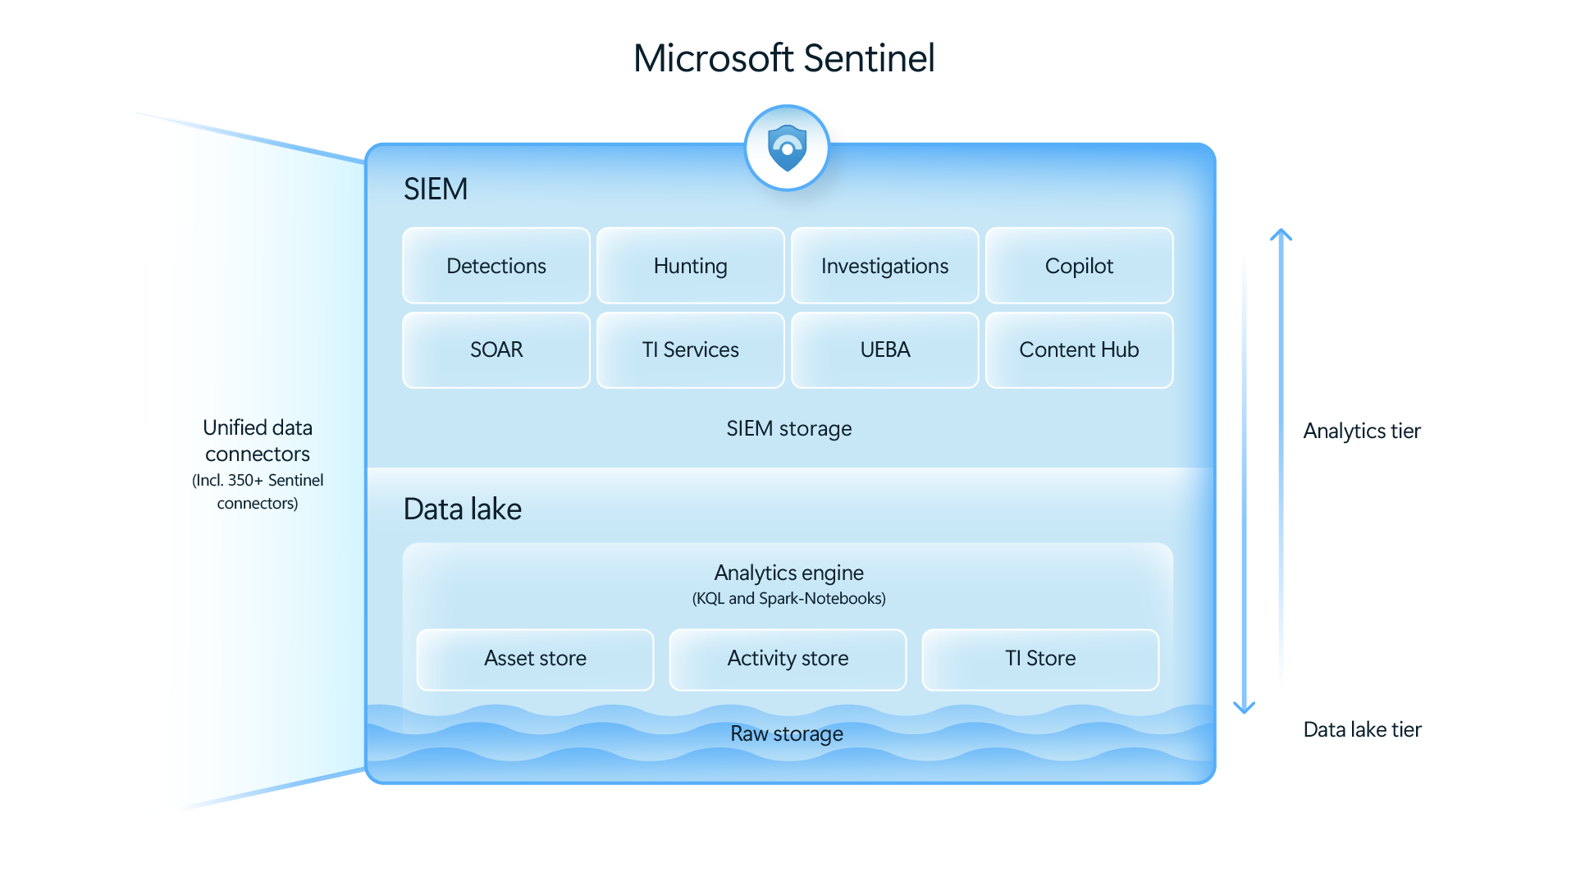

Slide 27
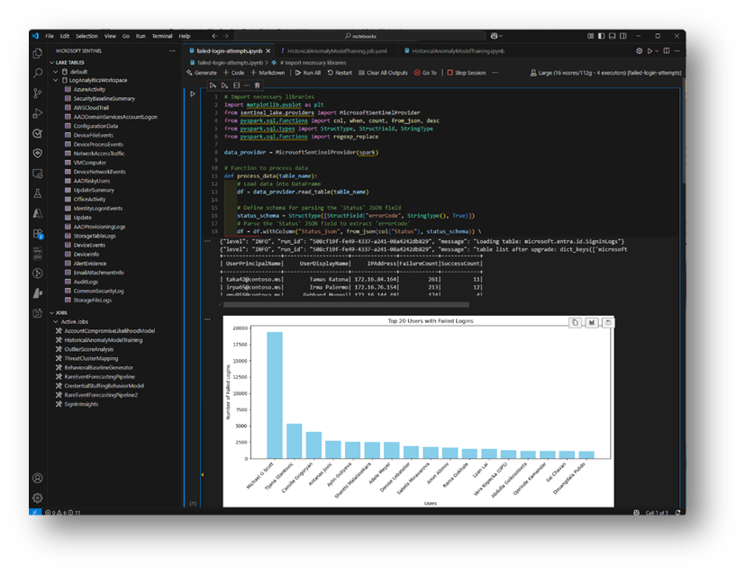

Slide 28
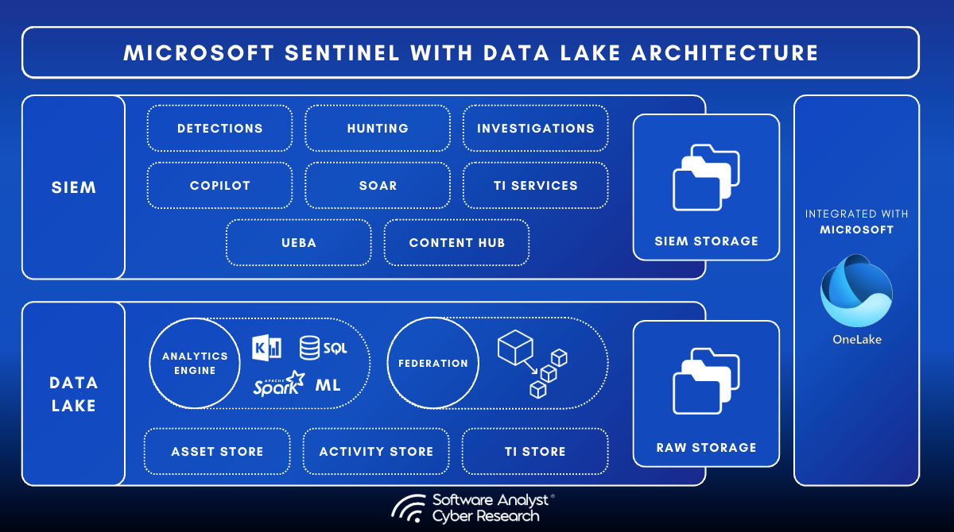

Slide 29
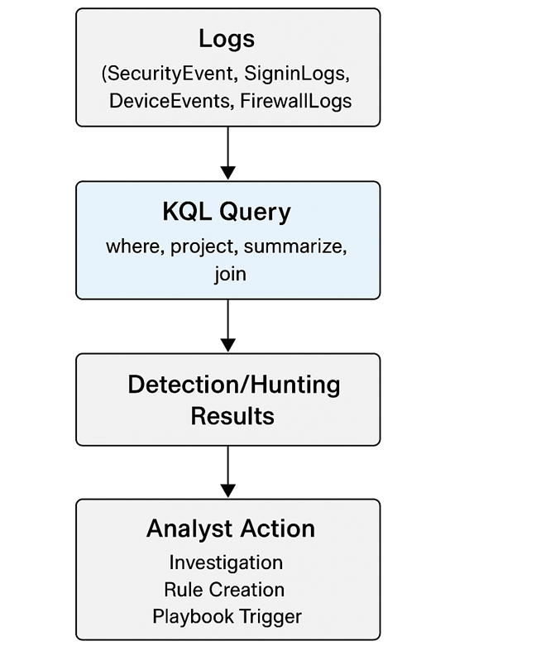
KQL & Sentinel
KQL is a large part of this
Investigation
Reporting and visualisation
Rules and playbooks
Watchlists

Slide 30
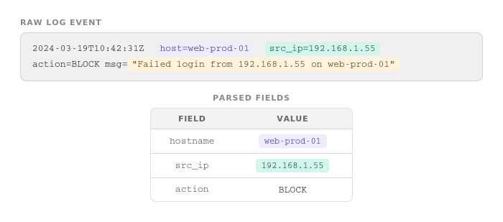
How to reduce ingestion?
What’s being used for your detection rules? Work backwards.
Raw event messages can be bulky. If other fields contain the same context, use those.

Slide 31
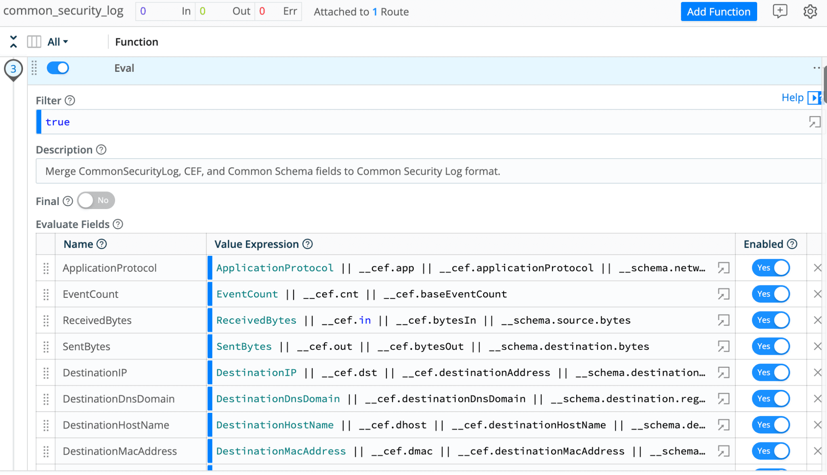
How to reduce ingestion?
Conform across your estate – are you sending everything in JSON or XML? Or both? Pick one.

Slide 32
Fundamentals
Security data is organisational data
Treat logs, alerts, and telemetry with the same rigour as any other business data.
Define before you collect
Know what you need and why before turning on ingestion.
Retention is a strategy, not a default
Align retention to compliance, risk appetite, and investigation needs.
Structure enables speed
Good schemas and queries: 10-minute investigation, not a 10-hour one.
Compliance supports security, but isn't security
Standards give you the framework; data design gives you the capability.

Slide 33
Next Steps
Audit your current ingestion
For each source: is it used in a rule, a report, or an investigation?
Document your retention policies
If they don't exist, create them. If they do, validate alignment with standards.
Define a schema for your top 5 log sources
Standardise the noisiest sources first. Conform on JSON or XML, not both.
Review your detection rules backwards
Start from your rules and work back to the data they actually query.
Build one proactive dashboard
Pick one use case and make it run continuously, not just post-incident.

Slide 34
Questions & Contact
Thank you! Questions?
Danny de Haan
Abhi Jayanty
Solutions Engineer, Redgate Software
Data Engineer, Quorum
/in/dannydh/
ThatInfraDba@pm.me
www.thatinfradba.com
/in/abhinav-j/
abhi.jayanty@outlook.com
Treating Security as a Data Discipline in Your Organisation

Slide 35

Interested in a live demo of Redgate Tools?
Discover how Redgate can add value to your data challenges through live demo today with a Redgate Solution Engineer. Head to the demo area or ask a friendly Redgate representative.
Networking and drinks reception
Join us for an opportunity to network during our drinks reception from 4:30 – 5:30pm.
Scan the QR code to leave your feedback:
Please leave us your feedback to access speaker slides and be in with the chance to win some prizes!
Winners drawn at the end of the keynote, you have to be present to win!

